Slide 1
1/8
An Implementation for
Logistic Regression
Under the guidance of Prof. V. Milutinovic
Presenter - Jayendra Khandare
(jkhandar@umail.iu.edu)

Slide 2
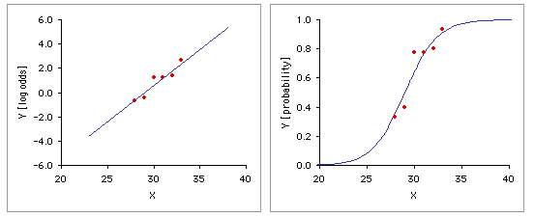
2/8
Logistic Regression[1]
This is a regression model where the dependent variable (DV) is categorical.
This project covers the case of a binary dependent variable.
  where it can take only two values, "0" and "1",
which represent outcomes such as
  Pass / fail,
  Win / lose,
  Alive / dead
  Healthy/ ill

Slide 3
Platform : Maxeler Systems
3/8
Maxeler develops hardware, software and provides other services which help to gain performance per unit of rack space.[2]
It also helps bringing down the power bill.
It is based on data-flow computing,
  Which focuses on optimizing the movement of data.
  Utilizes massive parallelism between 1000s of tiny cores
It has this concept of ‘skins’ which helps to implement the code using various languages like :
  Python
  R
  Matlab
  C

Slide 4
Implementation Details
4/8
dataGen( ) uses random number generator
  provided by <stdlib.h> to create binary values for y[ ].
printResults_DFE( ), printResults_CPU( ) simply prints results generated.
CPU( ) method executes as per control-flow model.
DFE( ) method executes the data-flow model.
In both of these methods :
  First, sums of deviations are calculated.
  Second, values of b0 and b1 are calculated based on formulas[3].
  Lastly, probabilities and odds are calculated using logit( ) function.
Outputs are compared and decided, if implementation was successful.
Finally, results are displayed.

Slide 5
Requirements for Acceleration
5/8
There are 6 requirements for a loop to be ported to data-flow model. [4]
The chosen loop satisfies some of requirements.
There are 2 loops which can be modeled to be one.
It contributes significantly to the execution time.
It executes for every entry in array y[ ].
It is dealing with not huge but moderate data.

Slide 6
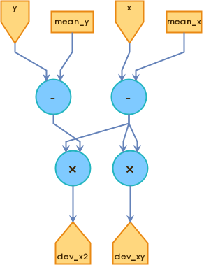
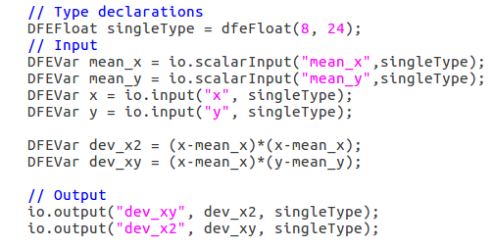
EngineCode
6/8

Slide 7
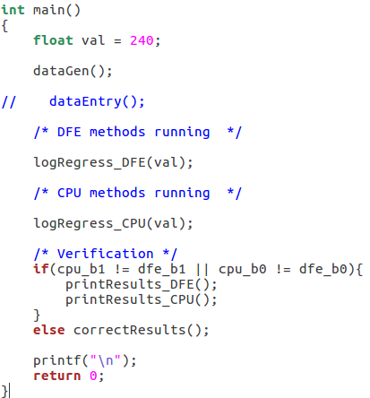
CPUCode
7/8
Value to check for probability
Random number generation
Logistic regression by DFE
Logistic regression by CPU
Verifying whether outputs are same
Printing results if they are correct

Slide 8
References
8/8
Logistic Regression Page maintained by Wikipedia.org
  – https://en.wikipedia.org/wiki/Logistic_regression
Information about Maxeler Technologies given at
  http://www.maxeler.com/
Formulas are given for least square method of regression.
- Linear Regression
- D. G. Simpson, Ph. D. [Prince George’s Community College, Maryland]
Instructions provided by Prof. V. Milutinovic
  for porting a loop into data-flow system.
  http://home.etf.rs/~vm/os/vlsi/predavanja/maxeler.html

